Slide 1

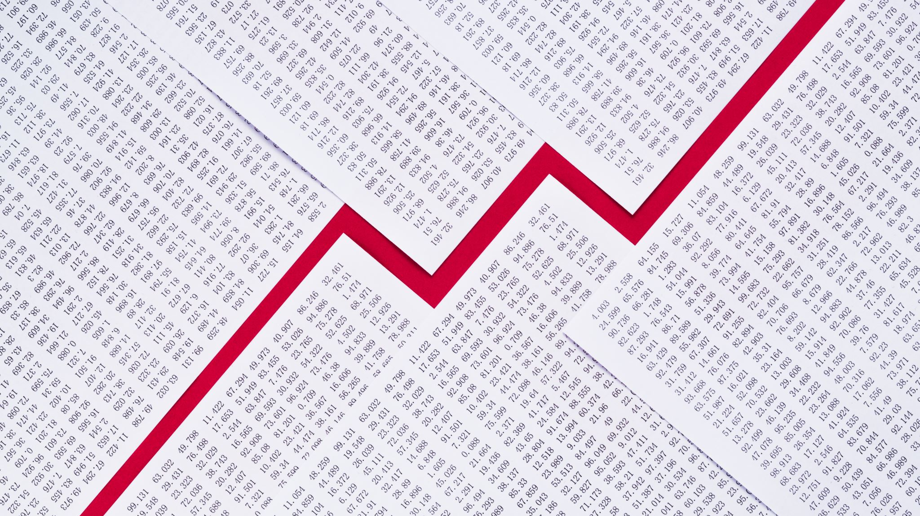
Predict the onset of diabetes based on diagnostic measures
By Mahmoud Sayed Youssef

Slide 2
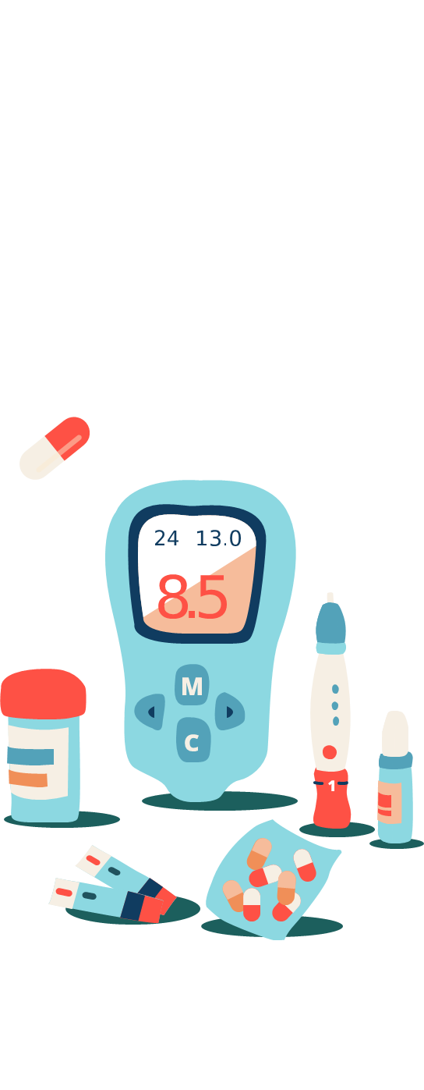

Introduction
Recent Swedish research has indicated that the risk of developing diabetes can be predicted 20 years in advance, as the body issues warnings that may help prevent the disease.
The study, which was conducted on more than 200,000 people without diabetes, found that nearly 9 percent of them were diagnosed with type 2 diabetes.
The researchers said that the results of the study indicate indirect rises in metabolic markers, even if levels are still in the normal range, and that individuals can know if they are at risk and take measures to avoid the disease before it occurs.

Slide 3
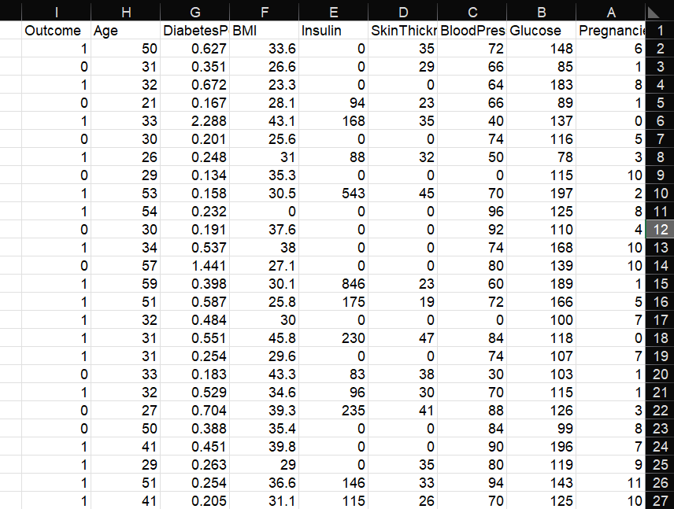
About the Dataset
The datasets consist of several medical predictor (independent) variables and one target (dependent) variable, Outcome. Independent variables include the number of pregnancies the patient has had, their BMI, insulin level, age, and so on.

Slide 4
Columns
Pregnancies: Number of times pregnant
Glucose : Plasma glucose concentration a 2 hours in an oral glucose tolerance test
BloodPressure : Diastolic blood pressure (mm Hg)
SkinThickness : Triceps skin fold thickness (mm)
Insulin : 2-Hour serum insulin (mu U/ml)
BMI : Body mass index (weight in kg/(height in m)^2)
DiabetesPedigreeFunction : It provided some data on diabetes mellitus history in relatives and the genetic relationship of those relatives to the patient.
Age : Age (years)
Outcome : Class variable (0 or 1) 268 of 768 are 1, the others are 0

Slide 5
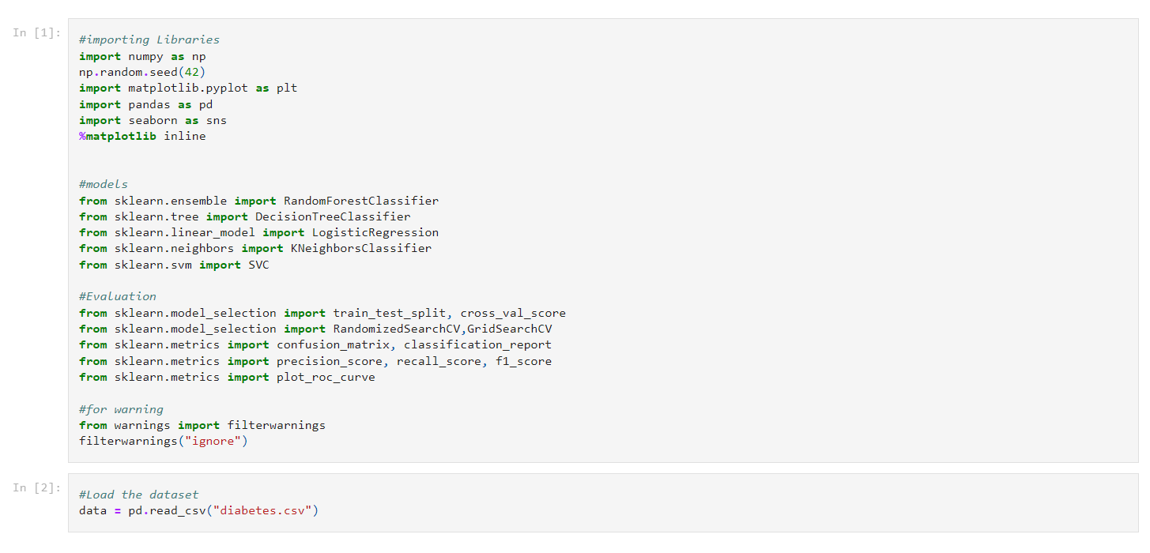

Slide 6
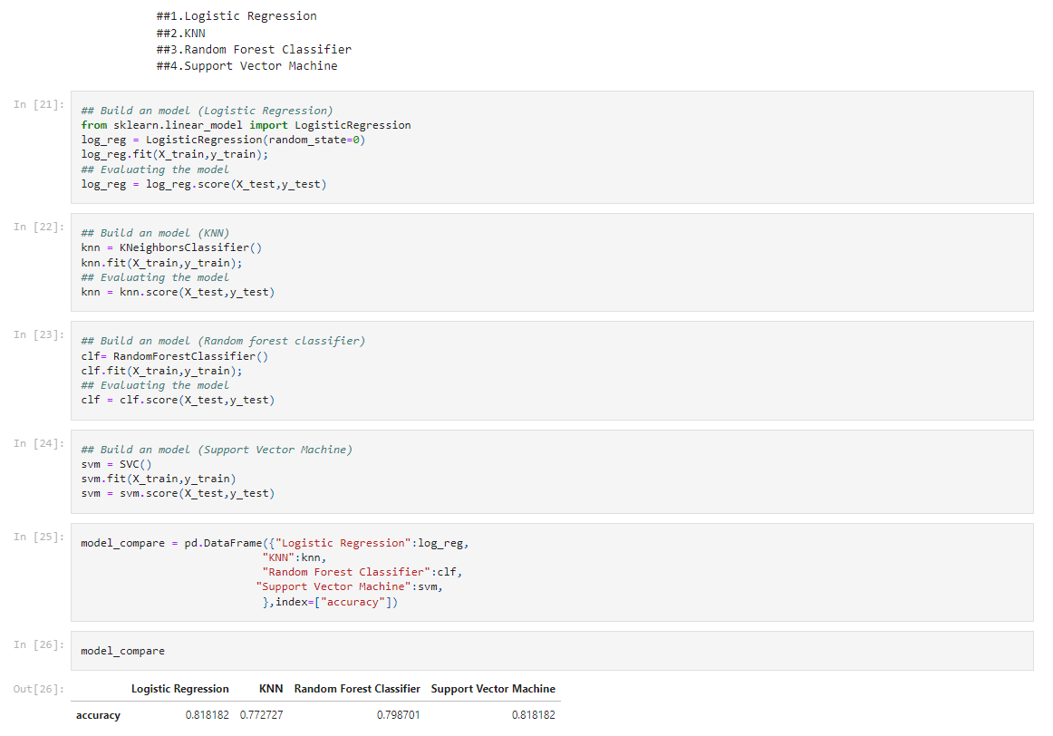
Trying Different Models:

Slide 7
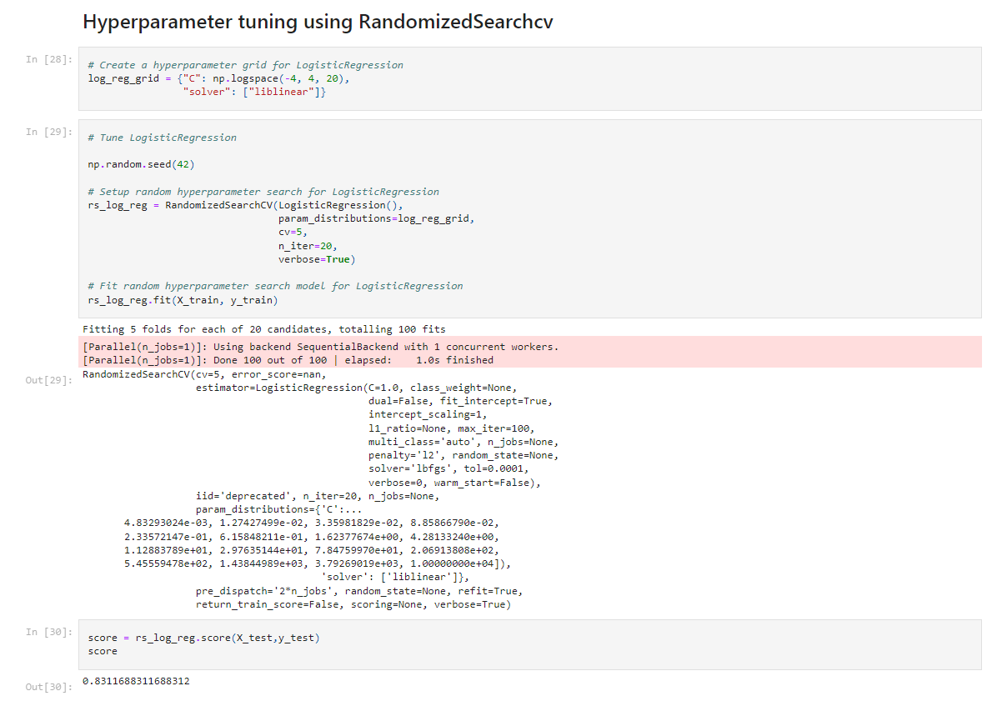
Best Model is logistic Regression with 83% accuracy

Slide 8
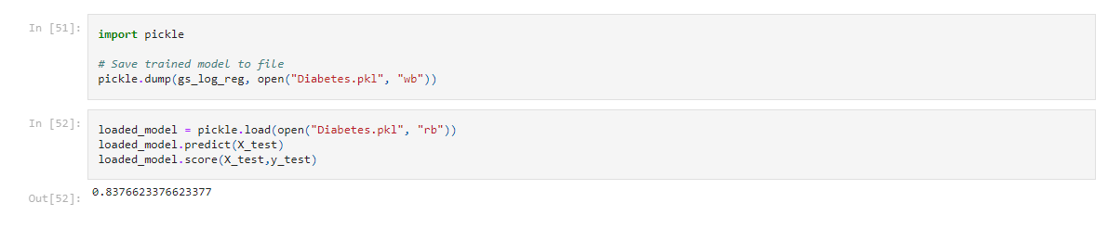
Loading and Saving a model

Slide 9
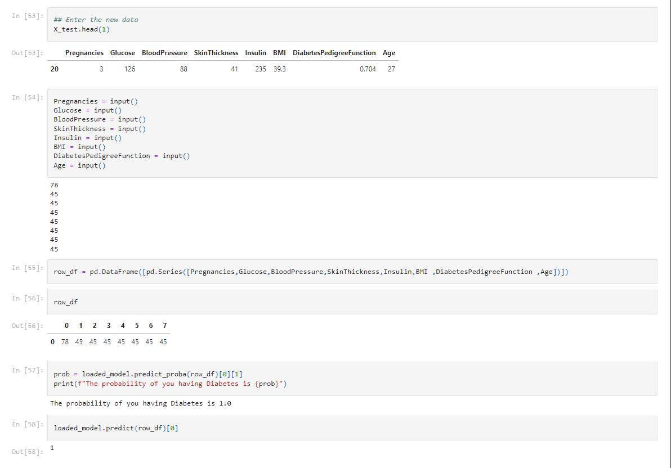
Predicting the Outcome Using New data

Slide 10
Adding the new data to the Dataset

Slide 11
Insulin in Human vs pig
From the beginning to the end of the story…

Slide 12
CONTENTS OF THIS TEMPLATE
Here’s what you’ll find in our slides:
Human insulin vs. Pig insulin
Problem chapter 15 : Generate the human or pig sequence.
Calculation of the GC content on the fasta files of human and pig insulin.
Discover the precentage of aligment in human and pig insulin.
Visualization plots on the comparison of human and pig insulin sequence.
Diabetes prediction based on the input data of the user that has been analysed.

Slide 13
01
Human vs pig insulin

Slide 14
INTRODUCTION
First we have to take a small brief about the diabetes and it’s side effects on the human health:
Diabetes mellitus refers to a group of diseases that affect how your body uses blood sugar (glucose).
And it’s side effects are:
1. Increased thirst.
2. Frequent urination.
3. Extreme hunger.
4. Unexplained weight loss.
5. Fatigue.
6. Blurred vision.

Slide 15
Under this experiment that shows how similar they are made by 3 doctors from department of pediatrics at oxford university:
The blood glucose control obtained when human insulin (insulin A) was compared with porcine insulin (insulin B) in 14 children. At the start of the study age, duration of diabetes, insulin dose, and daily carbohydrate intake were the same in both groups. After a one month run in period of standard treatment with porcine insulin the children were randomly divided into group 1 (three months of insulin A followed by three months of insulin B) and group 2 (three months of insulin B followed by three months of insulin A).
During each treatment period blood glucose control was assessed by clinical symptoms, and home blood glucose monitoring.
Although a significant difference in the period after lunch during 24 hour blood glucose profiles suggested a shorter onset time and faster peak action time of human insulin, no significant difference in the overall diabetic control was seen between the two types of insulin, and there was no significant difference in the daily insulin dose between porcine and human insulin.

Slide 16
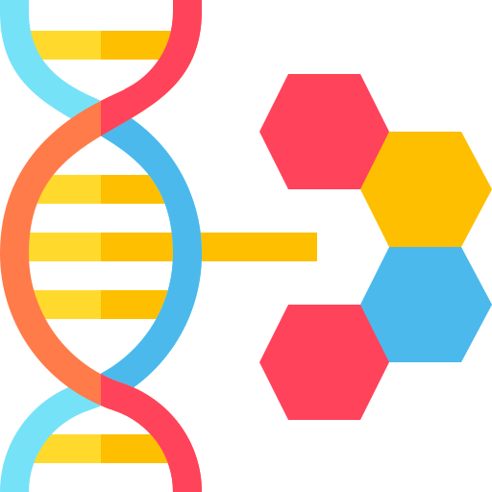
02
Project functions

Slide 17
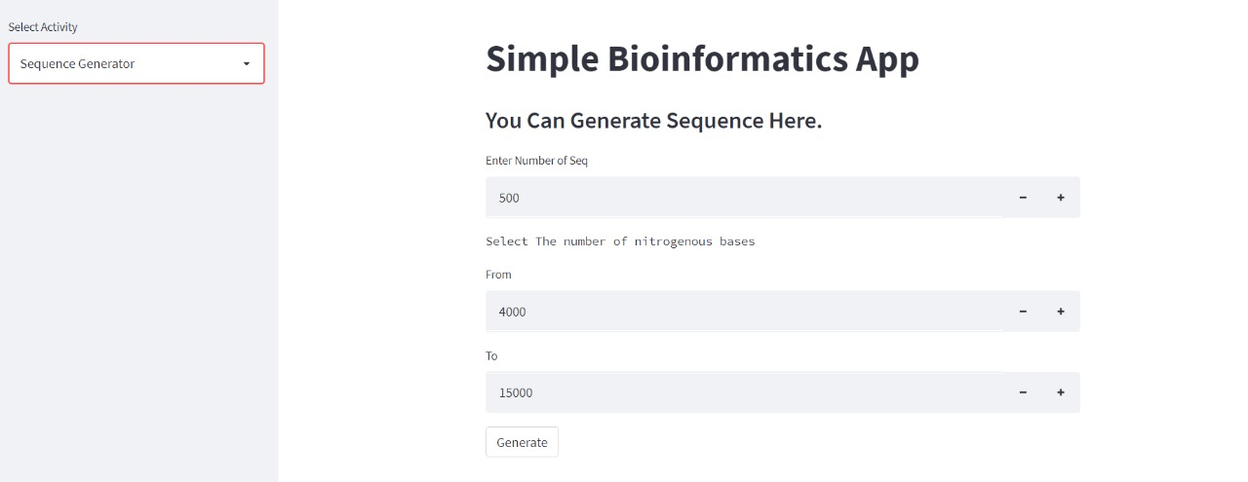
1. Sequence generation: we are going to generate the sequence if the sequence were null and the user forgot to enter the sequence or have no fasta file.

Slide 18
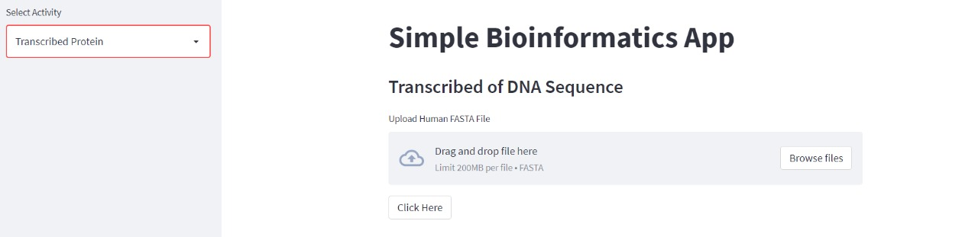
2. Translated protein: At this point, we are translating the RNA sequence to protein sequence.

Slide 19
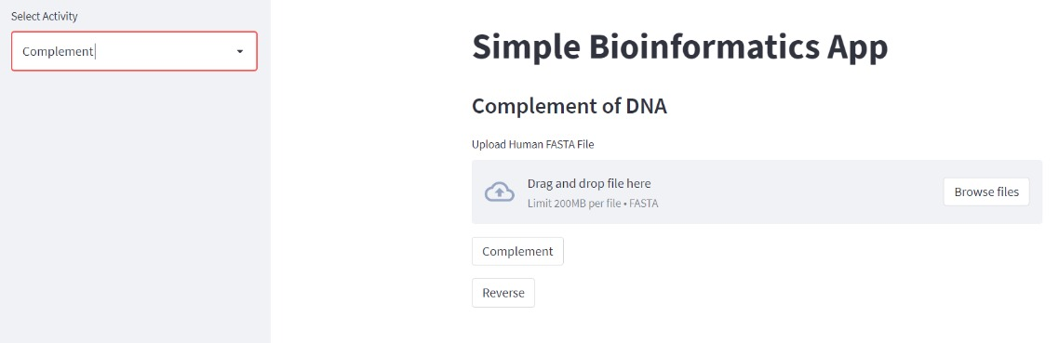
3. Complement: Third, we will complement the sequence we have to get its mirror.

Slide 20
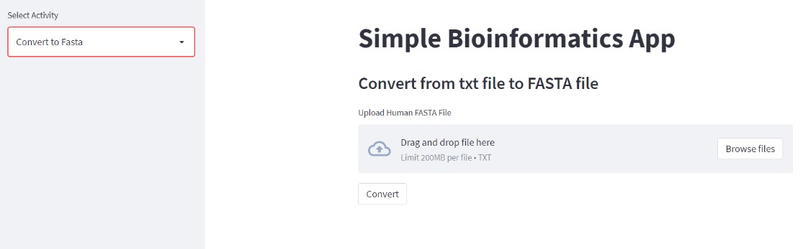
4. Convert to fasta: this function aim to convert the txt file which have the sequence to valid fasta file.

Slide 21
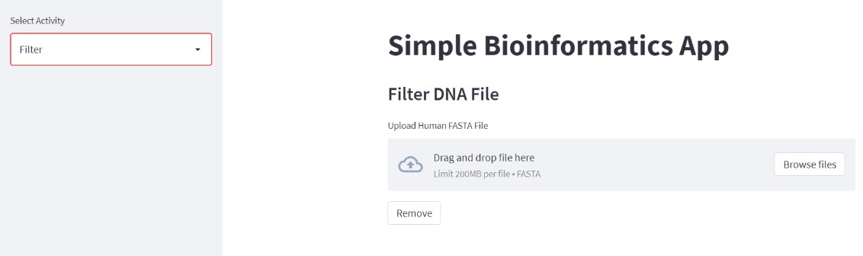
5. Filtering DNA file: This function seek to clear the sequence from any N-iteration and left it clear to complete the coming operations.

Slide 22
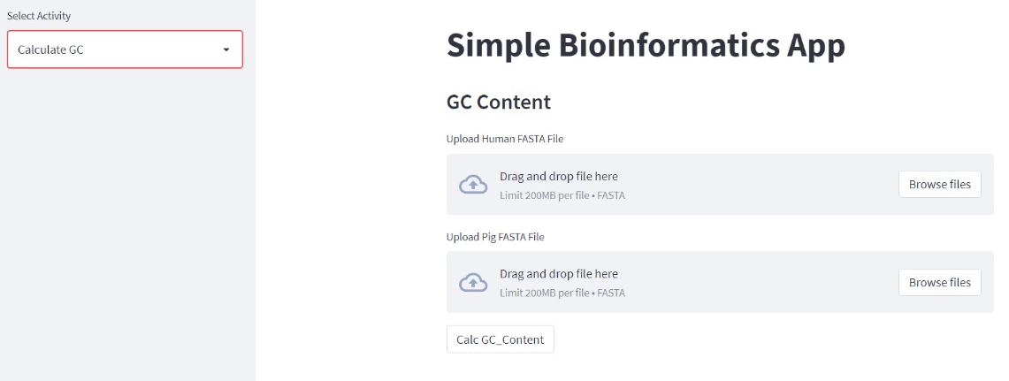
6. Calculate GC-content: This function is going to calculate the GC content of the sequence.

Slide 23
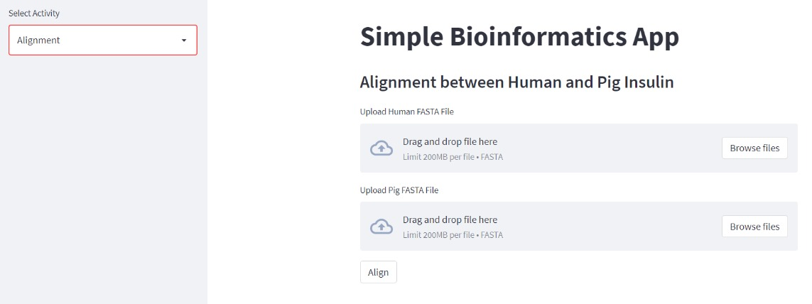
7. Alignment the 2 sequences: This function make alignment between the insulin of the pig and of the human.

Slide 24
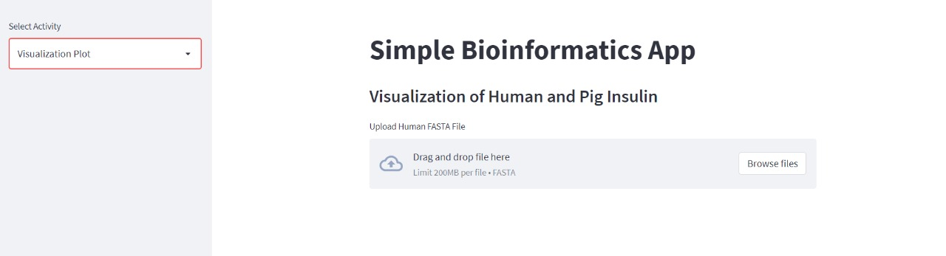
8. Vitualization: This function will show some visualizations that clarify the results.
Let’s show all of it with a slight description:

Slide 25
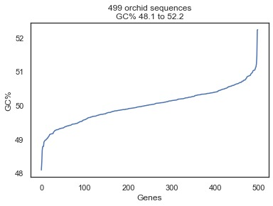
1) GC content: this visualization calculates the percentage of the C and G nucleotides of the sequence.

Slide 26
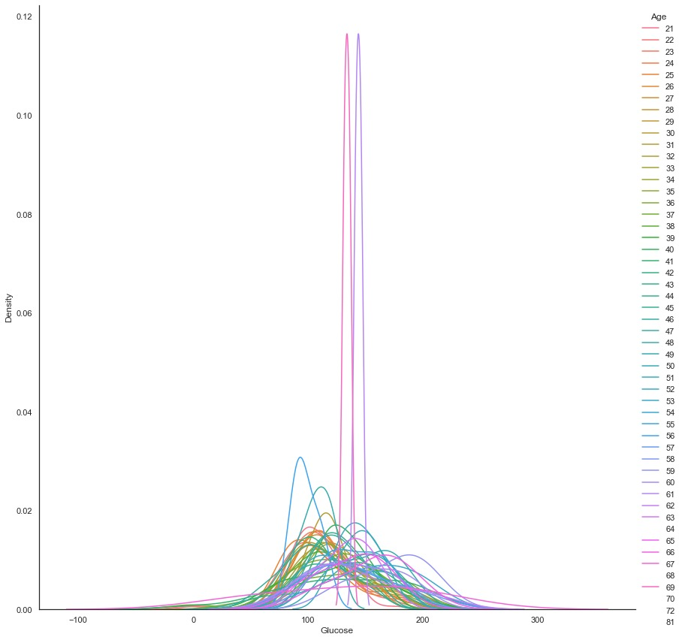
2) sns.FacetGrid: this visualization compare between the age and the glucose.

Slide 27
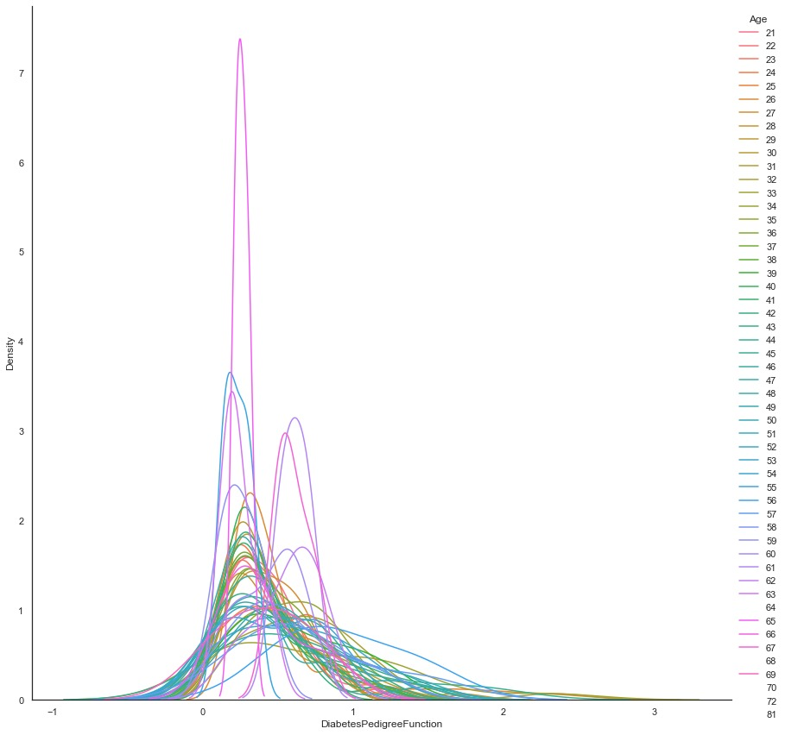
2) sns.FacetGrid: this visualization compare between the age and the diabetes.

Slide 28
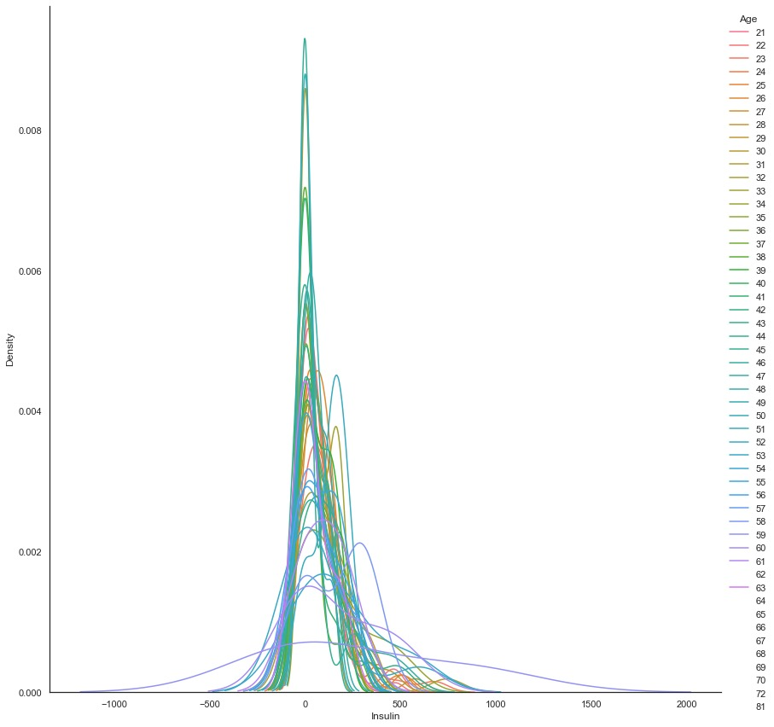
2) sns.FacetGrid: this visualization compare between the age and insulin.

Slide 29
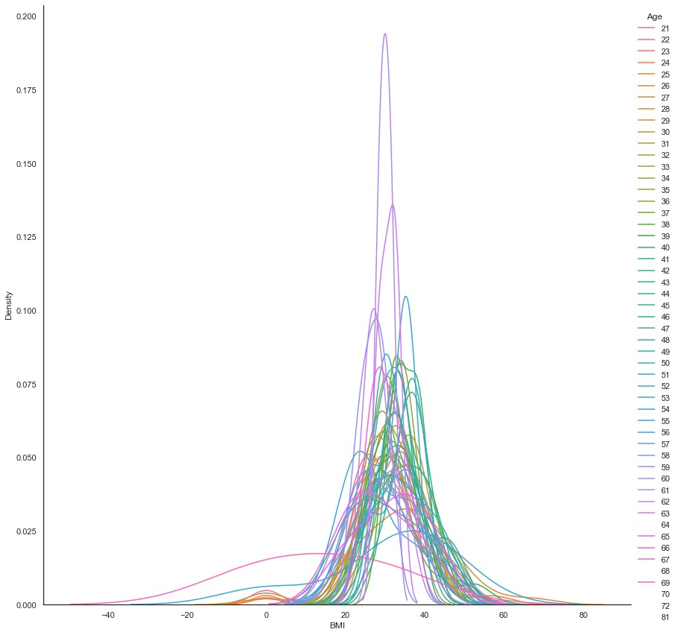
2) sns.FacetGrid: this visualization compare between the age and the BMI.

Slide 30
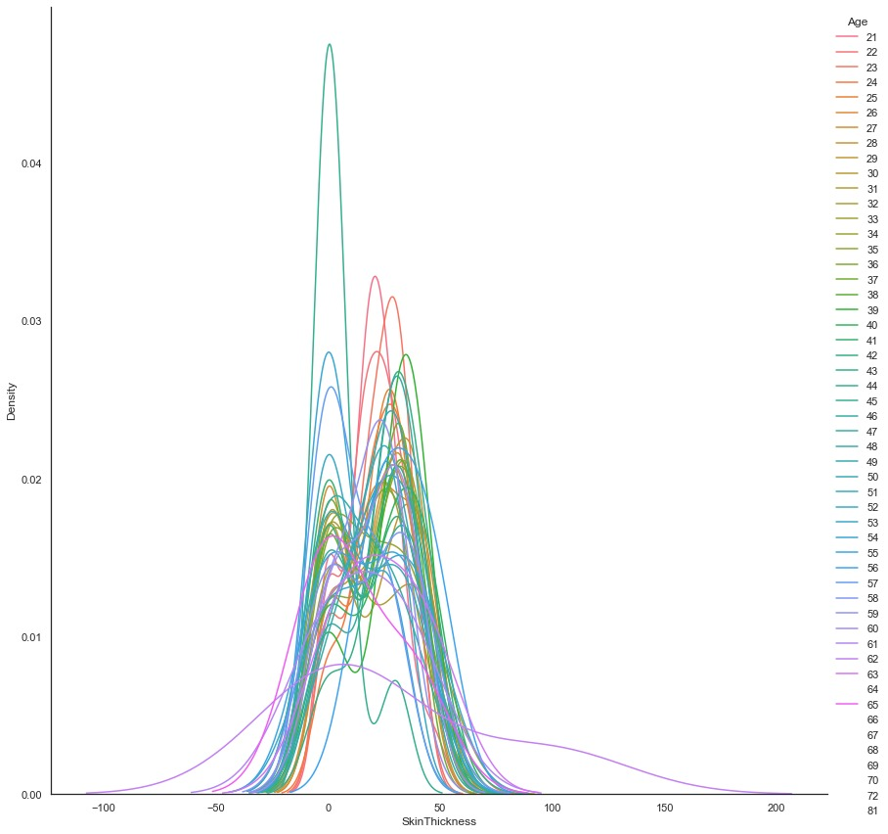
2) sns.FacetGrid: this visualization compare between the age and the Skin Thinkness.

Slide 31
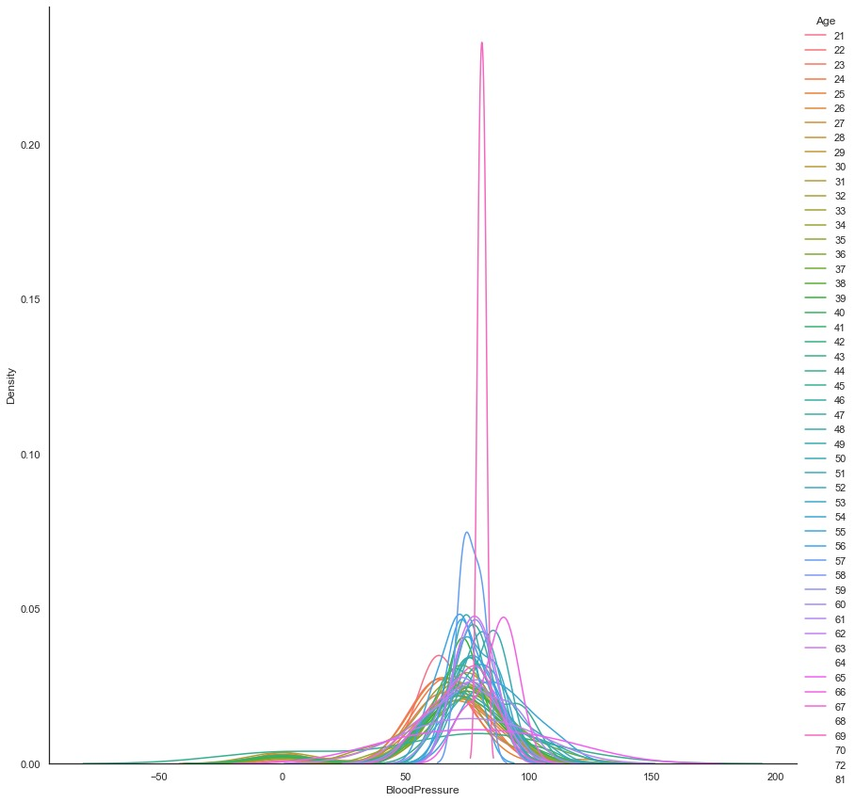
2) sns.FacetGrid: this visualization compare between the age and the Blood pressure.

Slide 32
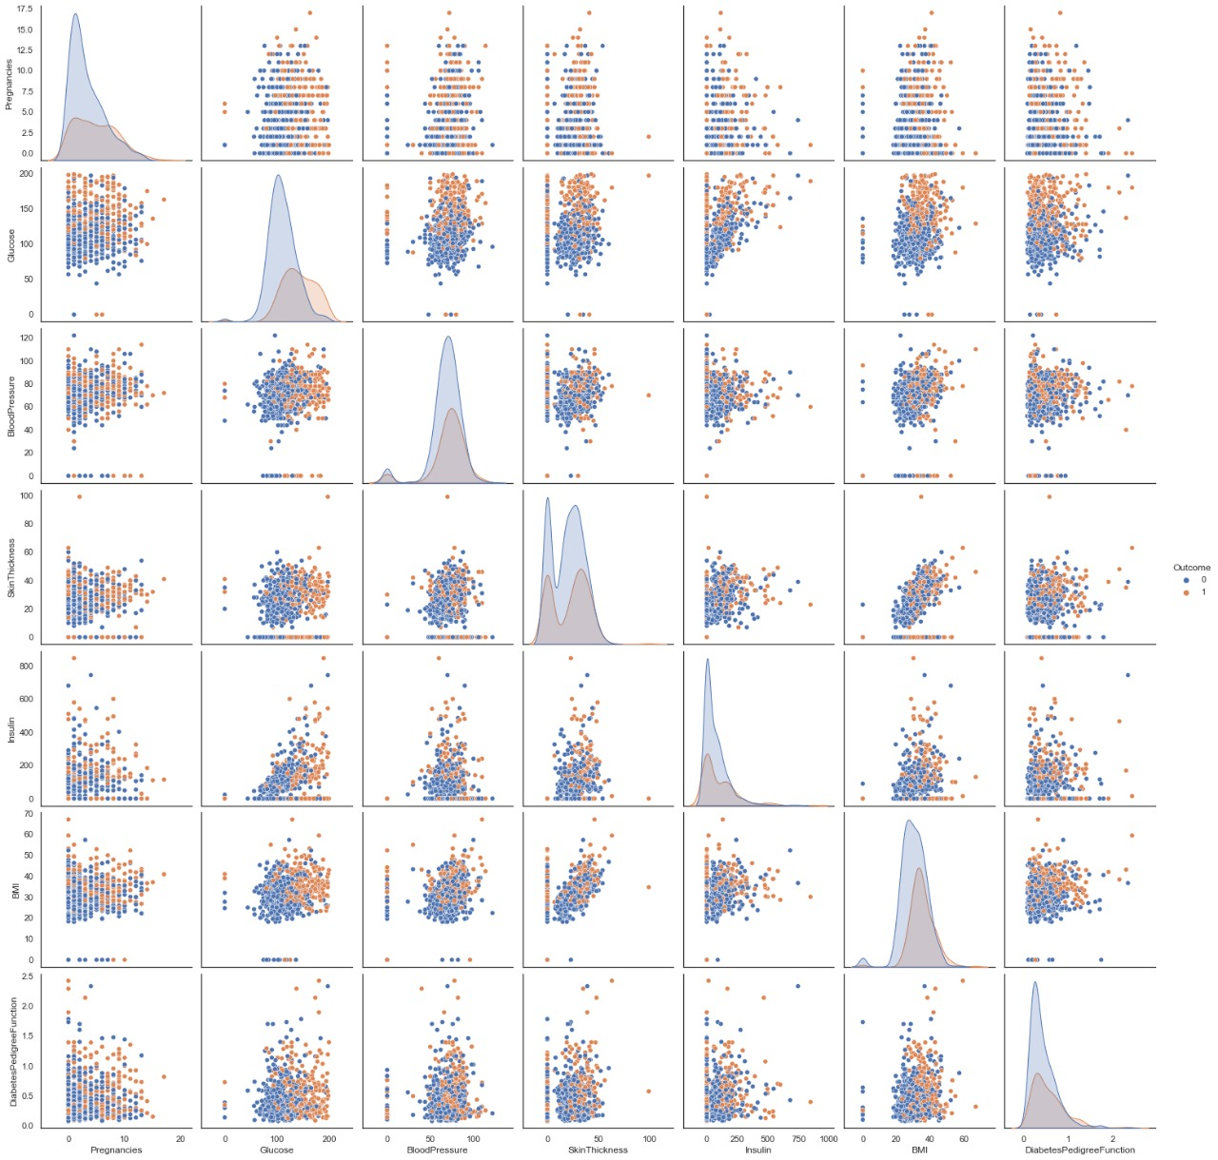
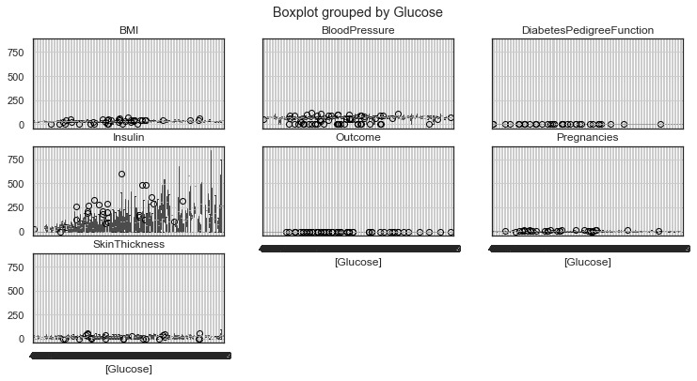
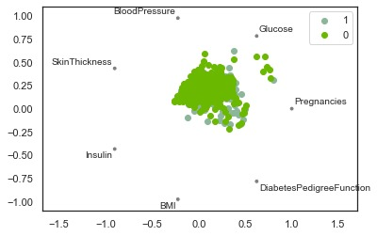
3) Analysis of diabetes: these visualizations calculates all the factors that causes the diabetes.

Slide 33
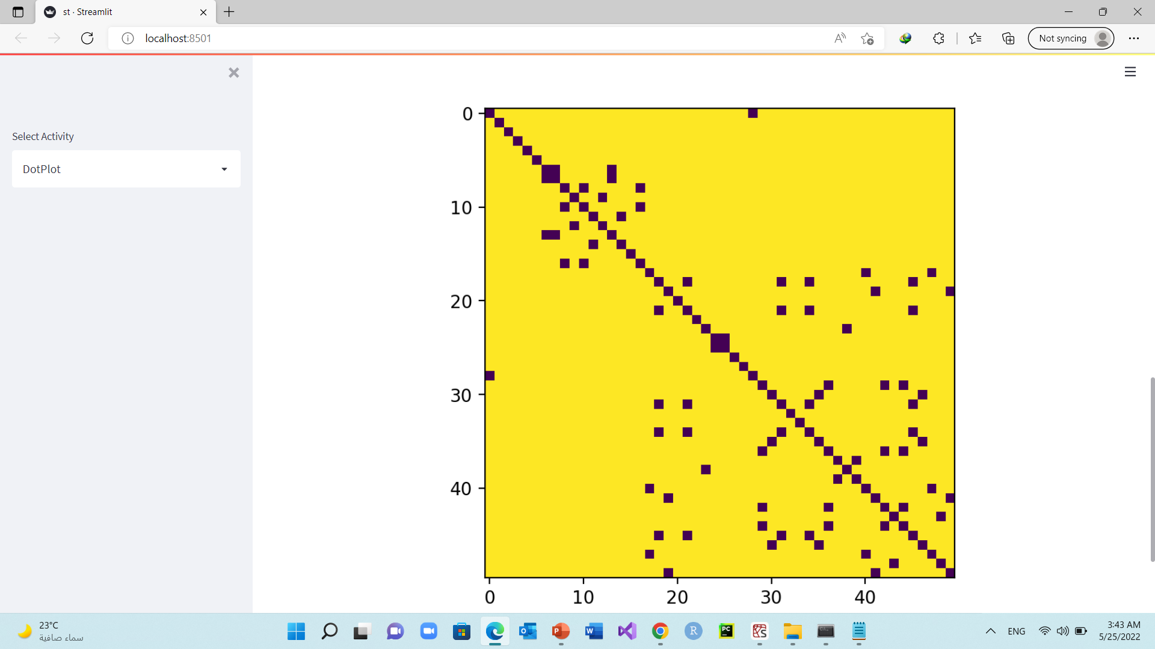
4) Dot Plot: this visualization comparing the data from human insulin and pig insulin.

Slide 34
Team Members:
Mahmoud Sayed Youssef Kotb (Group 4 section 1) “Leader”
Doaa Sayed Ibrahim Morsy (Group 2 section 1)
Rahma Yasser Mahmoud Abd- elsalam (Group 2 section 2)
Yasmeen Hossam El-din Mohamed Mahran (Group 4 section 4)
Mohamed Mamdouh Allam Ahmed (Group 4 section 1)
Mena Nashaat Fayez Khalil (Group 4 section 1)

